Slide 1
Microcalcification detection, clustering and features extraction
Presentation of 03/07/2023

Slide 2
I) Background, reminder of last meeting
II) Run the codes, inputs and outputs
Microcalcifications detection (CALC1) using deep-learning
Cancerous cell nuclei segmentation (HPV) and features extraction
Inputs and Ouptus
III) Proposed solutions
Summary
Direct on first step of HPV
Adapt to second step of HPV
IV) Conclusion and opening

Slide 3
I) Background, reminder of last meeting
Last time :
- Study of different publications about microcalcification detection, state of the art, only one was selected for its aforementioned characteristics (small point shape, speed, numbers of parameters, pre-trained models, and accessible code and dataset): CALC1
- New publication (HPV) about cancer cell nuclei segmentation (of similar shape of our microcalcifications) and statistics extraction
Settled objectives :
Run and understand both codes
Try to apply the statistics extraction part at the end of HPV code to the calcification image detected at the output of CALC1 code

Slide 4
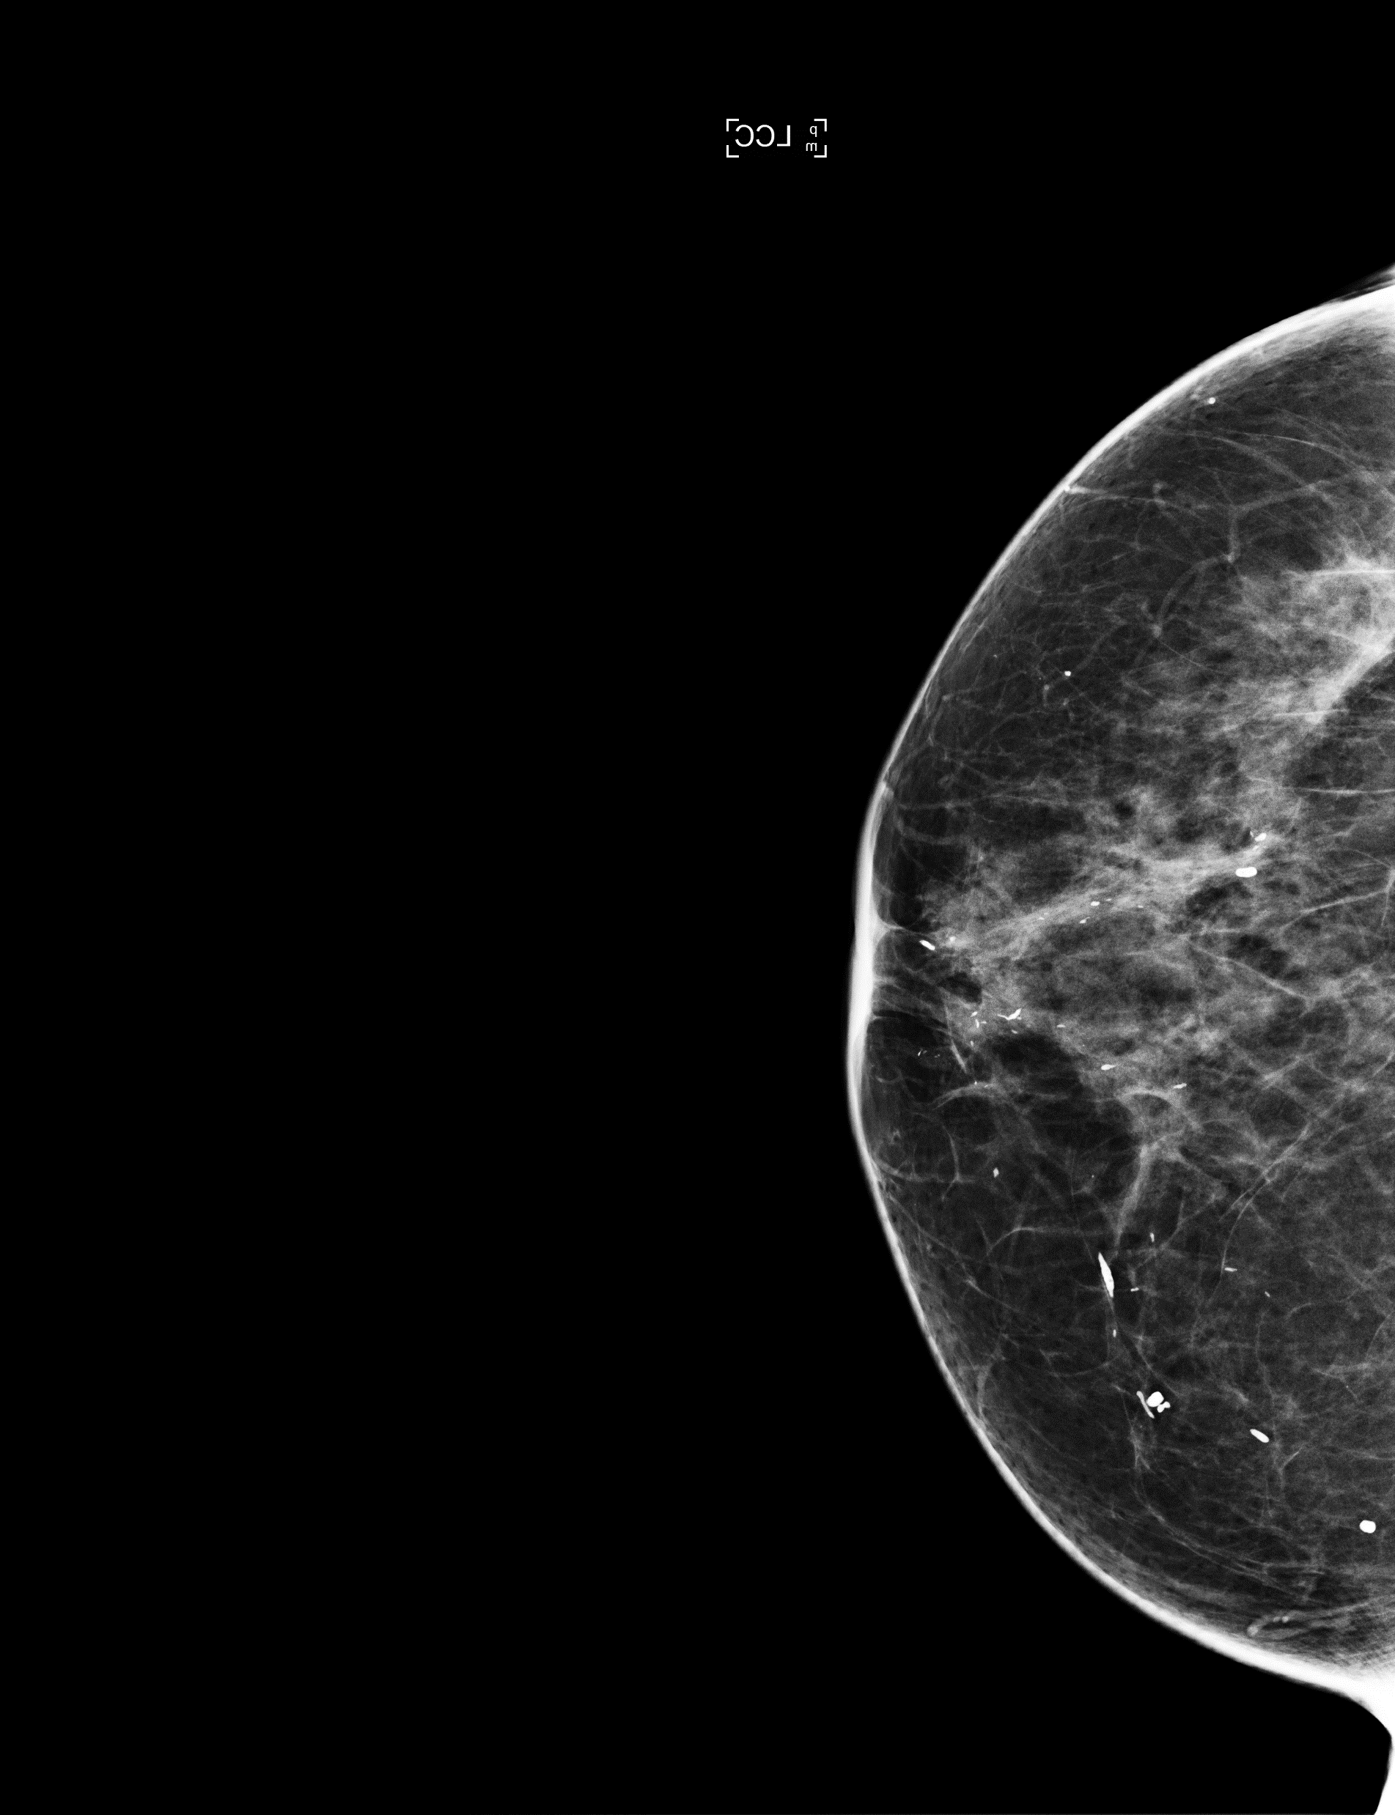
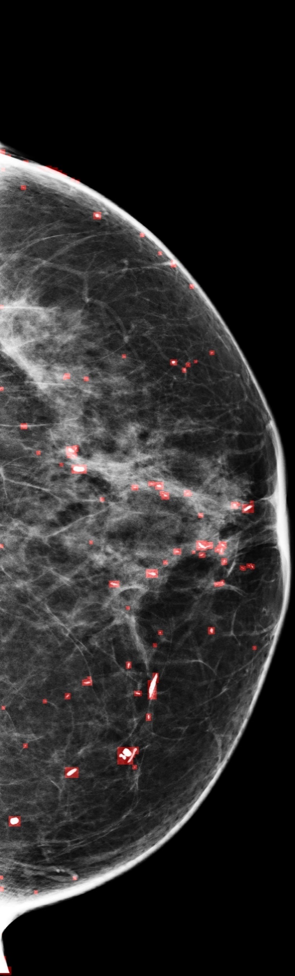
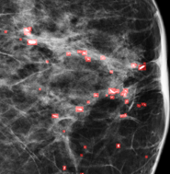
II) Run the codes, inputs and outputs
1) Microcalcifications detection (CALC1) using deep-learning
- Ran with the image furnished on the github
The original image, and the output, in red the microcalcifications detected
Zoom on microcalcifications area

Slide 5
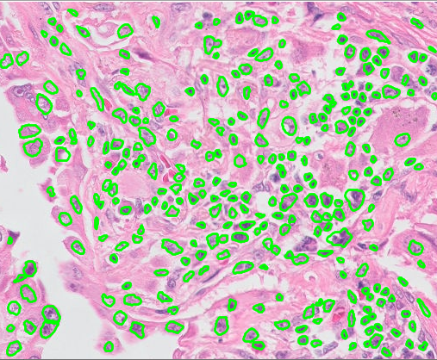
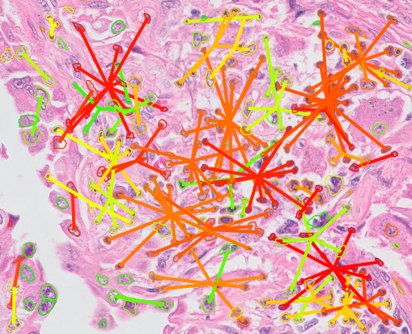
2) Cancerous cell nuclei segmentation (HPV) and features extraction
Ran the Matlab script show_example_v2 with the pre-fixed parameters and dataset :
Segmentation of the HPV cell nuclei
Clusterisation and extraction of the features from those segmented nuclei
Indeed the segmented nuclei are of similar shape of our microcalcifications
This code works in 2 steps: Segmentation and Clusterisation
- Need to study the inputs and outputs in order to combine both codes

Slide 6
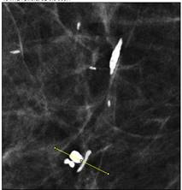
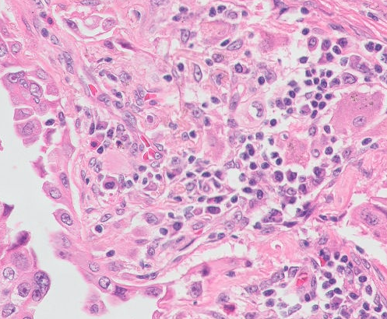
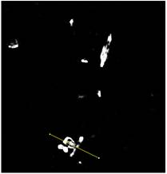
2) Inputs and Outputs
a) CALC1 output:
b) HPV step 1 input:
- « a scalar prediction score per-pixel»,
Png format: value between 0-255
- Point of interest ligther than background
Point of interest darker than background
Input
Output
- Value between 0-1 close to binary case:
~e-6
~1

Slide 7
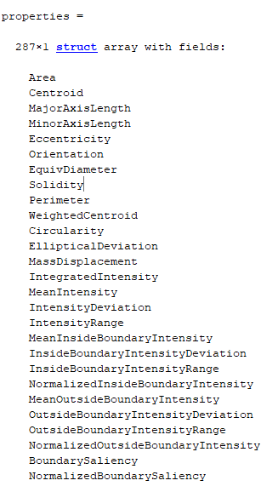
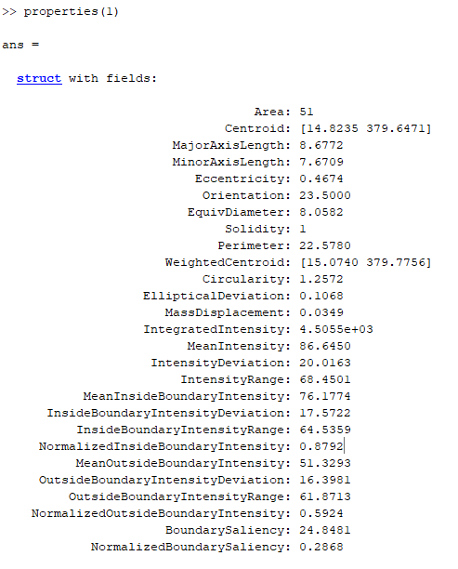
c) HPV step 1 output and step 2 input:
nuclei : list of length Number of nuclei
nuclei{k} corresponds to the chained list of points forming the boundary of the nuclei number k
properties : Number of nuclei * structure array
properties{k} corresponds to the properties of the nuclei number k
Exemple of struct properties:
Both are required as an input of step 2, especially getting properties will be the main issue

Slide 8
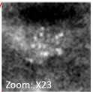
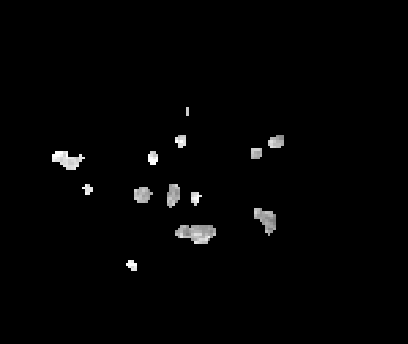
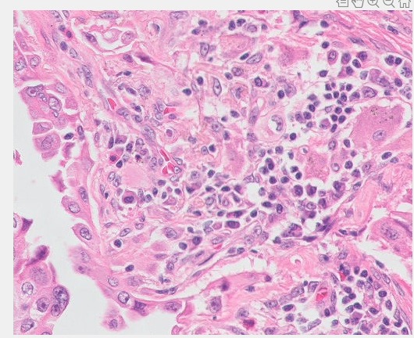
II) Proposed solutions
1) Summary
CALC1
Microcalcification detection
First Solution:
Adapt CALC1 output and step1 code
Second Solution:
Obtaining compatible properties and structures
HPV - Step 2
Grouping in cluster & computing characteristics on clusters
-List of compatible properties
-List of nuclei
HPV - Step 1
Dots segmentation & Characterisitics

Slide 9



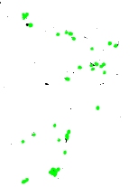
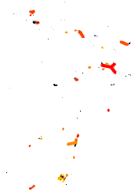




2) Direct on first step of HPV
Binarisation (remove background noise) | imout[imout<0.2] = 0 imout[imout>= 0.2] = 1
Non-binary segmentation | imout = imout * imout_old
Adapt the output of CALC1 to HPV: inversion and PNG format | imout = 1 - imout imout = imout * 255
-outputs of CALC1, step 1 and step2
-little zoom

Slide 10
IV) Conclusion and opening
Method considered | Issues | Shortcomings / Advantages | Current state of the code | Opportunities for improvement
Merge on Step 1 | - Watershed morphology algorithm -> parameters tailored for nuclei - Adapt output of CALC1 | - Impossible if strong apriori in step 1 + Greater characteristic coherence | - Tried to adapt the output of CALC1 - Not yet delve into Watershed paramaters | Try to adapt the parameters of watershed
Merge on Step 2 | - Hard to get the properties list by the same way | + avoiding detection error from step1, - Less coherence | - Not implemented

Slide 11
3) Adapt to second step of HPV
- not implemented yet
-
- This slide hasn’t been used in 03/07 meeting, because not sure of this time-consuming (time-consuming to implement) method (anyway I probably wouldn’t have succeed in implementing the second solution before the meeting) and wanted to have the opinions of our supervisors before pursuing further

